Slide 1
Don’t Tweet That!
Developing social media policies & safeguards
Dan Metcalf, Jr. – Cottonwood Heights P.R. Specialist

Slide 2
The “Anonymous” Megaphone
Social, or “anti” social media?
Anonymous?
Public
Viral
Eternal

Slide 3
Examples
Stand up For Tammy

Slide 6
Examples
Stand up For Tammy
I Have a Dream

Slide 8
Examples
Stand up For Tammy
I Have a Dream
What’s a Dongle?

Slide 9
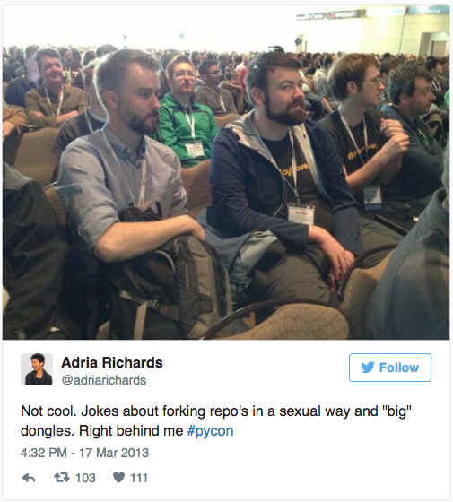

Slide 10
Examples
Stand up For Tammy
I Have a Dream
What’s a Dongle?
Crowd Control

Slide 11
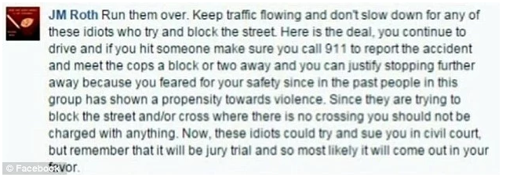

Slide 12
Examples
Stand up For Tammy
I Have a Dream
What’s a Dongle?
Crowd Control
#HasJustineLandedYet

Slide 13
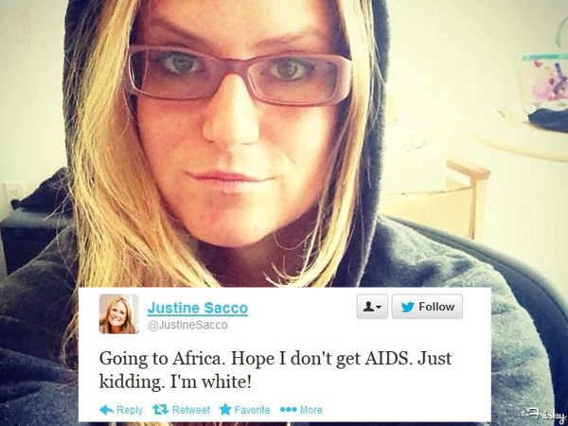
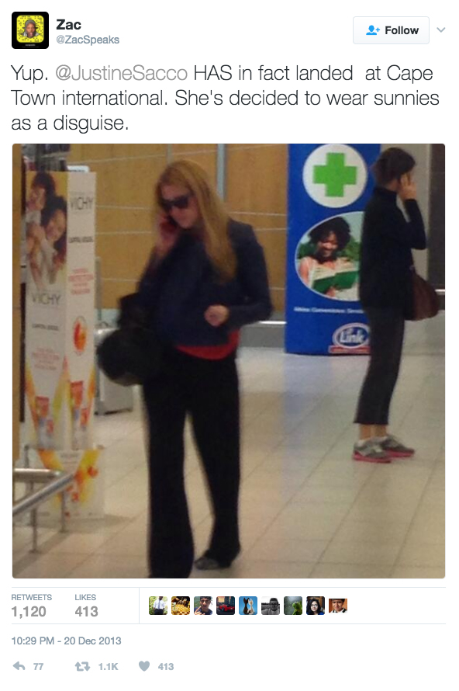
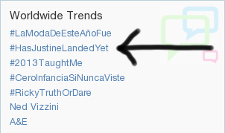

Slide 14
Examples
Stand up For Tammy
I Have a Dream
What’s a Dongle?
Crowd Control
#HasJustineLandedYet
A Little Respect

Slide 15
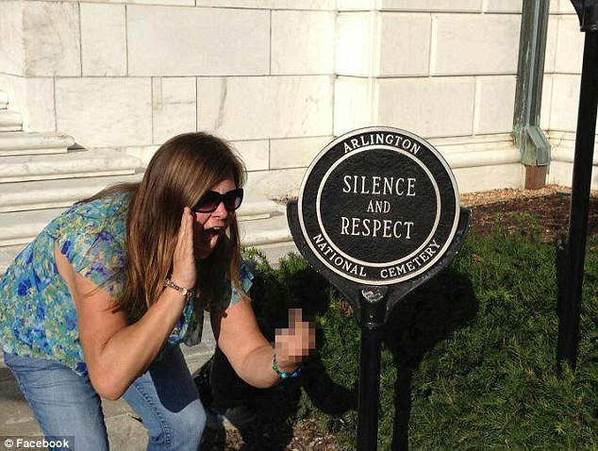

Slide 16
Examples
Stand up For Tammy
I Have a Dream
What’s a Dongle?
Crowd Control
#HasJustineLandedYet
Arlington respect
Justice for All

Slide 17
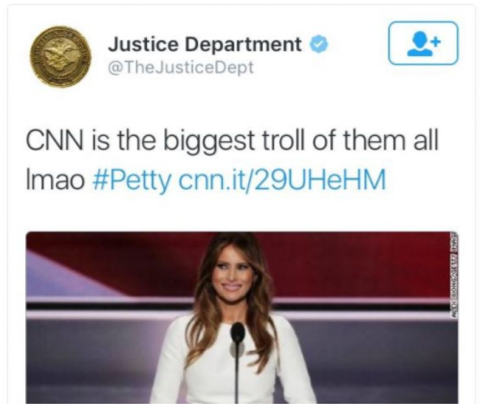

Slide 18
Examples
Stand up For Tammy
I Have a Dream
What’s a Dongle?
#HasJustineLandedYet
Arlington respect
Justice for All
You Seem Tense

Slide 19
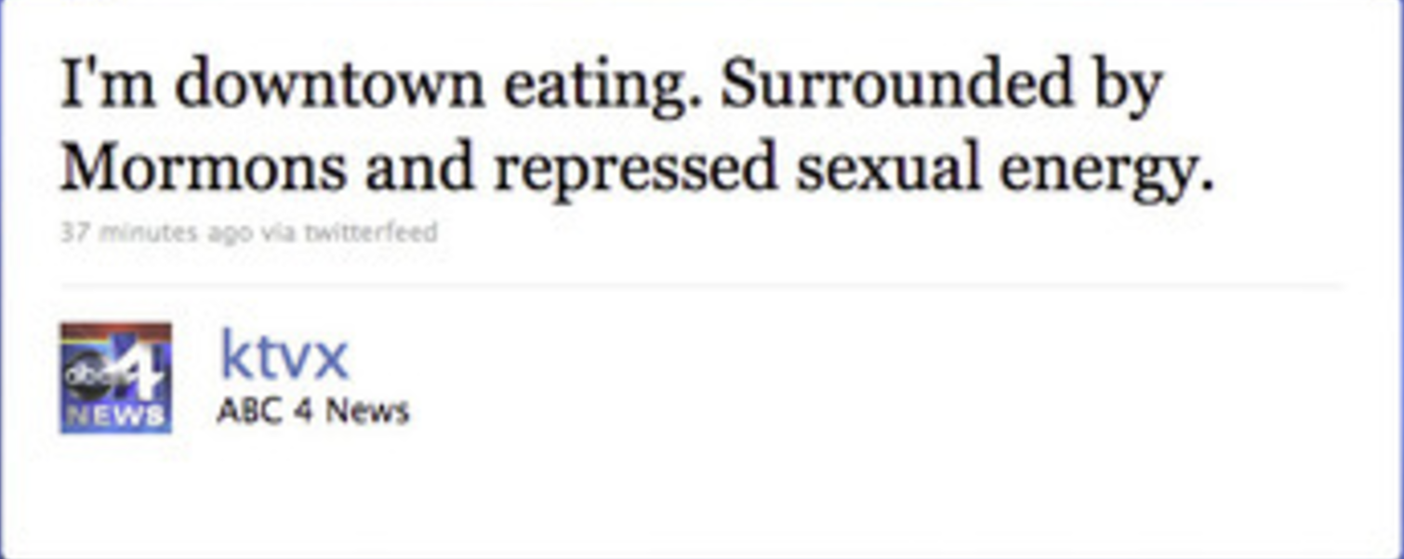

Slide 20
Policy: Internal & External
Internal:
Employee policy/manual
Training
Monitoring
Best Practices
Number of people with access

Slide 21
Policy: Internal & External
External:
Definitions
“Provider”
“User”
“Page” (channel)
Liability

Slide 22
Policy: Internal & External
Posting Policy:
(justification for removal)
Off-topic
Political candidate/cause
Discrimination
Personal attacks
Obscenity
Spam/advertising
Copyright
Provider policy
Security/safety
(Contact)

Slide 23
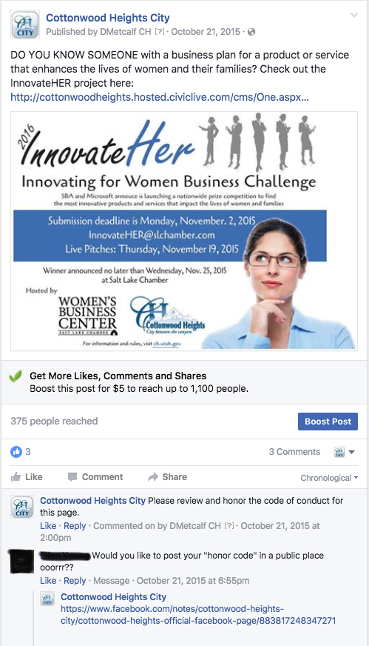
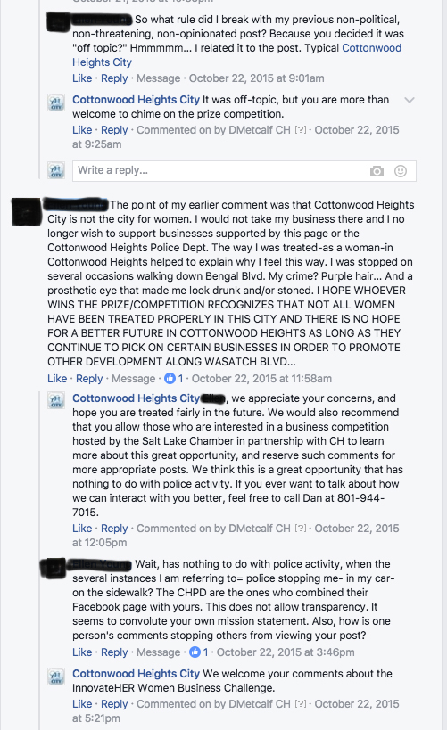

Slide 24
GRAMA
Does social media content fall under state open records laws?
(maybe)
Content is part of public record
Who owns the content?
Oregon, North Carolina, Texas

Slide 25
GRAMA
From the Pennsylvania Right to Know Law:
“Record.” Information, regardless of physical form or characteristics, that documents a transaction or activity of an agency and that is created, received or retained pursuant to law or in connection with a transaction, business or activity of the agency. The term includes a document, paper, letter, map, book, tape, photograph, film or sound recording, information stored or maintained electronically and a data-processed or image- processed document.

Slide 26
Utah’s Definition
"Record" means a book, letter, document, paper, map, plan, photograph, film, card, tape, recording, electronic data, or other documentary material regardless of physical form or characteristics:
(i)that is prepared, owned, received, or retained by a governmental entity or political subdivision; and
(ii)where all of the information in the original is reproducible by photocopy or other mechanical or electronic means.

Slide 27
Risks
2014:
After two years of litigation, a Honolulu Federal Court ordered the Honolulu Police Department to pay $31,000 in attorneys fees to Second Amendment activists who sued, alleging First Amendment violations after the HPD allegedly removed plaintiffs Facebook comments from an HPD Facebook page.

Slide 28
Archiving/Retention
Archive Social
Smarsh
PageFreezer
Do it yourself

Slide 29
Questions/Discussion
Or:
(“When will this guy shut up so we can take a break, already?”)

