Slide 1
2018 session recap

Slide 2
ULCT mantra as your advocates
BRING PEOPLE ALONG
FRIDAY FACTS/daily legislative email
Conferences/trainings
Technical expertise groups
GOVERNMENT CLOSEST TO THE PEOPLE GOVERNS BEST
PROBLEM SOLVERS/PARTNERS
With legislators, county officials, members of Congress, & the Governor’s office

Slide 4
www.ulct.org (legislative advocacy)

Slide 5
Local control and our legislative prism
What is local control?

Slide 6
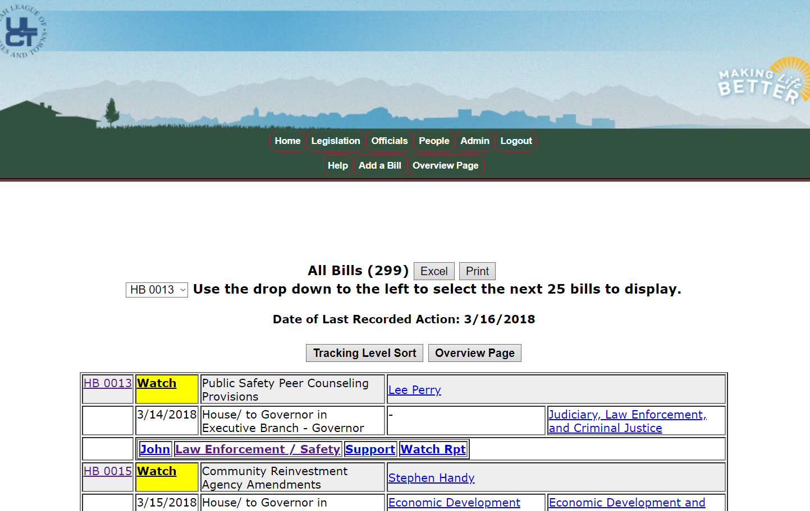
Bill tracking www.ulct.org

Slide 7
Legislative Policy Committee
Body that gives ULCT staff legislative direction
273 members
Average attendance: 130+
107 cities and towns
Every city/town entitled to 3 voting members
ULCT-USU partnership
202 people, 53 cities & towns
Hatch to Vernal and Nibley to Ephraim
CHECK THE ROSTER on www.ulct.org

Slide 8
ULCT board of directors
Grantsville Council Member Jewel Allen
Naples Mayor Dean Baker
Park City Mayor Andy Beerman
Richfield Council Member Richard Barnett
Green River Mayor Pat Brady
Ogden Mayor Mike Caldwell
North Logan Council Member Damon Cann
West Valley City Council Member Don Christensen
Herriman Council Member Nicole Martin
Heber City Mayor Kelleen Potter
Layton Mayor Bob Stevenson
Sandy City Council Member Steve Fairbanks
Bountiful Council Member Beth Holbrook (President)
St. George Mayor Jon Pike (1st VP)
Spanish Fork Council Member Mike Mendenhall (2nd VP)
North Salt Lake Mayor Len Arave (Treasurer)
Kaysville Mayor Steve Hiatt (Immediate Past President)

Slide 10
General themes of the 2018 Session
Housing
Housing affordability, affordable housing, homelessness
Infrastructure
Transportation, water, small cells, inland port
Transparency & accountability
Tax reform
Kicking the can
Tension between state and local authority
Libertarian and anti-government streak
Property rights
Mistrust of local government?
Oversight Committee
Inland Port
Disposable containers

Slide 11
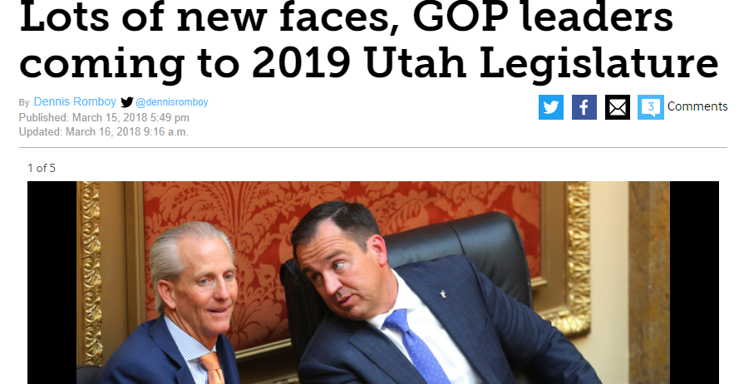

Slide 12
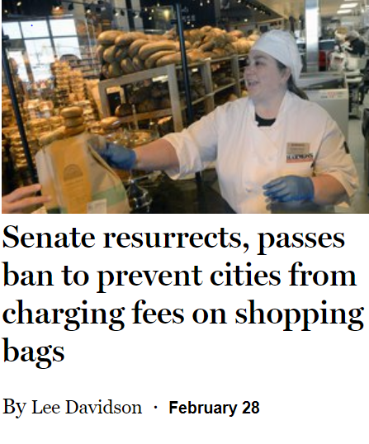
Tactics of anti-government special interests

Slide 13
The 45-day sprint
1,742 bill requests
821 bills/resolutions considered
533 bills passed (64.9% passage rate)
ULCT tracked 299/821 bills (36% of total bills)

Slide 14
ulct ENGAGED on these bills
HB 16 Candidate Replacement Amendments
HB 17 Community Reinvestment Agency Amendments
HB 38 Fireworks Restrictions
HB 72 Communications of Governmental Entity Employees and Officers
HB 79 Private Attorney General Doctrine
HB 88 Electronic Cigarette and Other Nicotine Product Amendments
HB 111 Community Reinvestment Agency Modifications
HB 113 Candidate Filing Amendments
HB 124 Water Holdings Accountability and Transparency Amendments
HB 126 Offender Housing Amendments
HB 135 Extraterritorial Jurisdiction Amendments
HB 136 Federal Designations
HB 138 Good Landlord Program Amendments
HB 168 Political Subdivision Lien Authority
HB 175 Legislative Oversight Amendments
HB 181 Home Consumption and Homemade Food Act
HB 182 Local Option Sand and Gravel Tax

Slide 15
ulct ENGAGED on these bills
HB 203 Nighttime Construction Noise Amendments
HB 209 Mental Health Protections for First Responders
HB 221 Animal Welfare Act Amendments
HB 225 Initiatives, Referenda, and Other Political Activities
HB 226 Citation Authority Amendments
HB 247 Amusement Ride Safety Inspections
HB 248 Compensatory Service in Lieu of Fine Amendments
HB 250 Building Permit and Impact Fees Amendments
HB 253 Trust Lands Amendments
HB 255 Extra-jurisdictional Municipal Property
HB 256 Electric Service District
HB 259 Moderate Income Housing Amendments
HB 265 Body Camera Amendments
HB 268 Off-Duty Employment of Law Enforcement Officer
HB 271 Government Enterprise Amendments
HB 279 Design Professional Liability Amendments
HB 294 Municipal Forms of Government Amendments
HB 298 Victim Advocate Confidentiality Amendments

Slide 16
ulct ENGAGED on these bills
HB 301 Legal Notice Amendments
HB 303 Drinking Water Source Sizing Requirements
HB 305 Fire Code Amendments
HB 336 Fire Amendments
HB 358 State Database Amendments
HB 359 Allocation of Fault Amendments
HB 361 Billboard Amendments
HB 373 Waste Management Amendments
HB 377 Land Use Amendments
HB 393 Lobbyist Expenditure Amendments
HB 430 Affordable Housing Amendments
HB 450 Wastewater Reuse Amendments
HB 455 Damage to Underground Utilities Amendments
HB 462 Homeless Services Amendments
HB 466 Wildland Fire Liability Amendments
SB 28 Local Government Limited Purpose Entity Registry
SB 29 County Listing of Local Government and Limited Purpose Entities
SB 36 Local Option Sales and Use Tax Distribution Formula Amendments

Slide 17
ulct ENGAGED on these bills
SB 24 Local Government Indigent Defense Requirement
SB 52 Sale of State Land Act
SB 66 Emergency Vehicle Operator Duty of Care Amendments
SB 83 State Real Property Amendments
SB 96 Canal Amendments
SB 111 Community Reinvestment Agency Changes
SB 120 Local Government Fees and Taxes Amendments
SB 128 Transportation Revisions
SB 136 Transportation Governance Amendments
SB 154 Prohibition of Law Enforcement Quotas
SB 155 Towing Amendments
SB 158 Municipal Business Licensing
SB 167 Food Truck Regulation Amendments
SB 183 Land Use Notice Amendments
SB 189 Small Wireless Facilities Deployment Act
SB 192 Retail Bag Impact Reduction Program
SB 204 Secondary Water Metering Requirements
SB 234 Utah Inland Port Authority
SB 235 Homeless Shelter Funding Amendments

Slide 19
Key bills for UMCA by category
General: HB 175, HB 38, HB 324, SB 167, SB 158, SB 80
Elections: HB 16, HB 113, HB 35, HB 141, HB 281, HB 218, SB 17, SB 74, SB 38, HB 225
Transparency/accountability: HB 134, SB 28, SB 29, SB 82, SB 105, SB 178
GRAMA/Records: HB 72, HB 56, HB 66, SB 137
Finance/taxes: HB 168, SB 122, SB 124
Land use/building: HB 377, HB 361, HB 279, SB 111
Transportation: SB 136, SB 120, SB 71, HJR 20
Waste: HB 373, SB 218
Water/infrastructure: HB 303, SB 189, SB 234
Homelessness/Housing: HB 259, HB 430, HB 462, SB 235

Slide 20
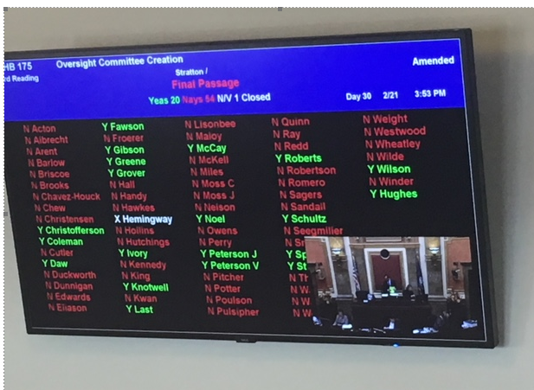
Key bills: general
HB 175 – Legislative Oversight Amendments (FAILED)
Originally would have had authority to “examine an action of a local government entity in relation to the entity’s application of a law passed or a rule authorized by the Legislature.”
committee made entirely of legislators would examine the “efficiency” and “effectiveness” of a local government act.
Successful in removing all local government oversight from this bill.

Slide 21
HB 175 (FAILED)

Slide 23
Key bills: general
HB 38: Fireworks Restrictions
Allows local fire code official to consider existing OR historical hazardous environmental conditions to prohibit fireworks in previous areas plus
Dry grass areas
200 feet of waterways, trails, canyons, washes, ravines, or similar areas
And a limited area outside of the hazardous areas in order to facilitate a “readily identifiable closed area”
The legislative body or state forester must make a finding that the historical hazardous environmental condition has existed in the defined area before July 1 of at least 2 of the last 5 years AND produce a map of the defined area before May 1 of each year to the county.
The county must create a county-wide map before June 1 indicating each area where fireworks are prohibited, provide the map to retailers and the state fire marshal, and post it on the county website.
Retailers must display a sign that indicates the legal discharge dates and the penalties for illegal discharge.
Also reduces the days fireworks can be sold and discharged. Now may be sold from June 24 through July 25 and discharged from July 2-5 and 22-25. (Winter is unchanged.)
A person who negligently, recklessly, or intentionally causes or spreads a fire through fireworks is liable for the costs of suppression and any damages.

Slide 24
Key bills: general
HB 226 – Citation Authority Amendments
Remember last year’s SB 251 Local Government Criminal Penalty Amendments?
A municipal officer or official who is not a sworn law enforcement officer may not issue a criminal citation for a violation that is punished as a misdemeanor.
NEW LAW –
Only law enforcement officers or special function officers may issue citations for misdemeanors, except that a fire officer or an animal control officer may if the violation threatens the health and safety of an animal or the public.

Slide 25
Key bills: general
HB 324 – Tobacco Regulations Amendments
Adds “homeless shelter” to the definition of community location.
Changes the definition of retail tobacco specialty business – sale of tobacco products accounts for more than 35% of the total quarterly gross receipts; 20% or more of the retail floor space or shelf space is allocated to tobacco products; or there is a self-service display for tobacco products.
Provides that a city may not issue or renew a license for retail tobacco specialty shop without proof of a valid permit from the local health department and a valid license from the State Tax Commission.
Provides penalties for permit violations and changes fee provisions for tax commission licenses.

Slide 26
Key bills: general
SB 158 – Municipal Business Licensing
Clarifications that build on last year’s SB 81 re: home occupations.
Cities may not charge fees for home occupations unless the business creates offsite impacts that materially exceed the residential use.
States that a municipality may charge an administrative fee for issuing a license to a home-based business owner who requests a license but is otherwise exempt from a fee.
States that municipalities must notify home-based business owners that they may be exempt from licensing fee “in any communication with the owner.”

Slide 27
Key bills: general
SB 167 Food Truck Regulation Amendments
A city or county may not
require a fee for each food truck employee
Require the food truck to demonstrate how it will comply with land use or zoning at the time it applies for a business license.
Prohibit food trucks in a zone where other food establishments are allowed
Restrict the number of days per year a truck can operate
Require a site plan for each location the food truck operates if they permit operation in the public ROW
Require a site plan for private property where a truck operates less than 10 hours per week.
A city or county may
require a food truck to comply with local zoning and land use regulations
promulgate local ordinances and regulations on food truck operation.

Slide 28
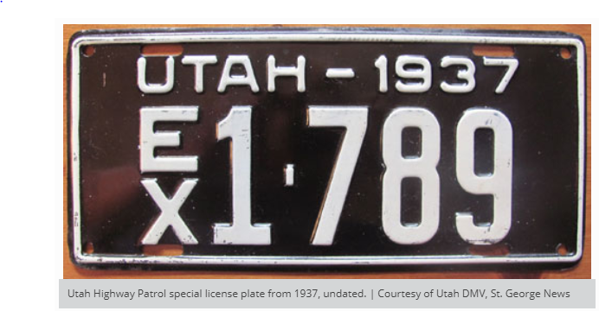
Key bills: general
SB 80 – Exempt and Apportioned License Plate Amendments
A vehicle with an EX or UHP license plate owned by a governmental entity is exempt from registration renewal requirements as long as the vehicle is registered and owned by the entity.

Slide 29
Key bills: elections
HB 16 – Candidate Replacement Amendments
Applies to vacancies in political subdivisions if
A nonpartisan primary election is held for the office
The vacancy occurs after the date of the primary but 65 days before the day of the general election; and
The number of remaining candidates is less than or equal to the number of open positions for the office.
An election officer shall fill a vacancy by certifying the next available candidate who received the highest number of votes in the primary.
HB 113 – Candidate Filing Amendments
Allows an individual to file a declaration of candidacy via a designated agent if:
the individual is located outside the state during the entire filing period,
the person’s designated agent appears in person, and
the potential candidate communicates with the local official via electronic device that allows the local official to see and hear the candidate.
The designated agent may not sign the declaration of candidacy form. The form should be modified in accordance with this statutory change.

Slide 30
Key bills: elections
HB 35 – Municipal Alternate Voting Methods Pilot Project
Creates a pilot project (20A-4-6) for a municipality to conduct nonpartisan municipal races by instant runoff voting. Begins Jan. 1, 2019 and ends Jan. 1, 2026.
City of the 3rd, 4th, or 5th class may participate during any odd-numbered year by providing written notice to the Lt. Governor before Jan. 1.
If a city that wants to participate in the pilot project has an ordinance stating that it will
In an instant runoff race, a voter indicates candidates in order of preference.
There will be a rulemaking process for how a counting judge is required to count ballots in an instant run-off.
Instant runoff voting:
First ballot-counting phase: The election officer shall declare a candidate who gets more than 50% of the first-preference votes the winner
Second ballot-counting phase (if no candidate gets more than 50% of the first-preference votes): candidate with fewest first-preference votes is excluded. If there is a tie b/t first -preference votes, the second-preference votes are added. Candidate with more than 50% of the votes wins; if not, then the process repeats

Slide 31
Key bills: elections
HB 141 – Early Voting Amendments
Permits a municipal clerk to reduce the early voting period if:
The clerk conducts early voting on at least 4 days
Those 4 days are within the period beginning 14 days before the election and ending on the day before the election.
The clerk provides notice of the reduced early voting period.
Notice – election officer must provide notice of the dates, times, and locations of early voting at least 19 days before the date of the election.
HB 281 – Voter Eligibility Amendments
Allows a 17-year-old who will be 18 on or before the general election to register to vote and vote in the primary.
SB 17 – Election Law Modifications
Modifies the date by which a candidate must have information submitted to the Lt. Governor for publication in the voter information pamphlet to the first business day in August before the election.
Political parties must notify the Lt. Governor of convention dates by February 15 of even-numbered years.
Requires a change to the declaration of candidacy form for write-in candidates.

Slide 32
Key bills: elections
HB 218 – Modifications to Election Law and SB 74 – Voter Privacy Amendments
A lot of technical changes.
Allows any individual to apply to the Lt. Governor or county clerk to have his or her entire voter registration record classified as private. No reason/evidence necessary.
DL or State ID card: registration forms will include a question on whether the applicant wants to use the information in the form for voter registration, whether the applicant wants to register as absentee to receive ballots by mail, and whether the applicant would like to request that his or her voter registration record be classified as private.
Provisional ballots: an individual who is not registered to vote may register and vote on election day or during early voting by voting a provisional ballot. If the provisional ballot and the voter meet certain criteria, the provisional ballot will be considered a voter registration form. The Lt. Governor will report to the Gov Ops interim committee in October 2018 and October 2020 on implementation of registration by provisional ballot.

Slide 33
Key bills: elections
SB 38 – Local Elected Officer Amendments
Establishes a process to remove a county elected officer from office for mental incapacity under Title 20A.
Only applies to counties with at least 5 members on the council and that opts in by ordinance.
Allows the council to make a preliminary finding that the officer does not have the mental capacity to fill the position with or without reasonable accommodation. If unanimous, the officer then has 5 days to resign, get an actual mental capacity evaluation, or do nothing.
If the council does not reach a unanimous decision, they publicly announce that the vote failed without disclosing details of the vote. They also provide reasonable accommodations if necessary and allow the officer to continue serving.
If the officer elects to have a mental capacity evaluation, the county and the officer must mutually agree on a qualified medical professional. If they don’t, the council can file for a court order. If the medical professional concludes that the officer lacks mental capacity, the officer may resign within 5 days. If he or she does not resign, the council may remove him or her from office in an open meeting by unanimous vote.
If the council unanimously concludes that the officer lacks mental capacity and the officer does not resign or agree to undergo an evaluation, the council may file an action in district court asking for a court order for the officer to undergo the evaluation.

Slide 34
Key bills: elections
HB 225 – Initiatives, Referenda, and Other Political Activities (FAILED)
ULCT work group, started in Dec 2016
Elected officials, administrators, clerks, attorneys, counties, Lt. Governor’s staff
Clarified timeline
Fiscal/legal impact, for/against arguments, signature gathering, clerks, pamphlets, dates
Clarified when the communication restrictions on the public entity begin
Adjudication of referability at beginning of process with codified standards
Signature requirements based on “active voters” rather than turnout
Codified policy objective of “equal access”
Clarified ability of city to respond to questions about referendum without violating state law
Many hostile amendments avoided

Slide 35
Key bills: transparency/accountability
HB 134 – Conflict of Interest Disclosure Requirements
If a public officer files a disclosure under the Election Code, he or she is exempt from having to make disclosures to their respective public entity regarding business interests.
SB 82 – Utah Transparency Advisory Board Amendments
Changes the appointment term for a member of the board from two years to four years.
Changes the election of a chair and vice chair from annually to every two years.

Slide 36
Key bills: transparency/accountability
SB 28 – Local Government and Limited Purpose Entity Register
Creates a registry of local government and limited purpose entities with the Lt. Governor.
Allows the state auditor to withhold certain state funds and property tax disbursements for non-compliance.
Allocated state funds to pay for the accounting report
Includes municipal entities, interlocal entities, governmental non-profits, counties, local substance abuse authorities, mental health authorities, local districts, CRAs, special service districts, local building authorities, conservation districts, local health departments, housing authorities.
Each entity must register by July 1, 2019 and include info enumerated in the statute.
Process for noncompliance before funds are withheld.
SB 29 – County Listing of Local Government and Limited Purpose Entities
Companion to SB 28
Requires each county to publish info on the county’s website regarding each local government entity and limited purpose entity in the county.

Slide 37
Key bills: transparency/accountability
SB 105 – Crime Statistics Reporting Amendments
Provides that the date collected under the statewide uniform crime reporting system shall not contain any information that reveals the identity of a crime victim or law enforcement officer.
Requires a law enforcement agency to submit crime reporting data to BCI before the 16th day of the month following when the crime occurred, in the form proscribed by BCI and the FBI.
Requires the agency to verify data within 10 business days of getting a request from BCI.
SB 178 – Interlocal Entities Amendments
Excludes “taxed interlocal entity” from the definition of “public body” under OPMA.

Slide 38
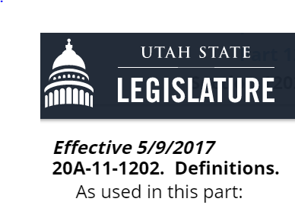
Key bills: GRAMA
HB 72 – Communications of Government Entity Employees and Officers
Provides that if a government employee uses his or her government email for a political purpose in violation of Title 20A, those emails are subject to GRAMA.
Violation determined by the entity’s records officer.

Slide 39
Key bills: GRAMA
SB 66 – Emergency Vehicle Operator Duty of Care Amendments
Agencies that operate emergency vehicles must have a written policy that describes how the operator must engage, conduct, and terminate vehicle pursuits, in accordance with state statute.
If a pursuit results in injury or property damage, the head of the agency must investigate whether the operator complied with the policy, including documenting it and remedying any violation of the policy.
Any document produced is subject to GRAMA.
HB 56 – Emergency Personnel Recording Amendments
If properly classified by a government entity, an audio recording made by first responders responding to an emergency and using life-saving equipment is protected if used for training purposes.
HB 265 – Body Camera Amendments
Any recording made by an officer while on duty may not be “owned” by a private entity.
Agencies may still use a private entity to store or redact video.

Slide 40
Key bills: GRAMA
SB 137 – Amendments Relating to Government Records
Provides that a recording, transcript, report, and written minutes of a closed meeting are protected under GRAMA (used to say just recording and written minutes were protected).
Directs that the state records committee may send written notice of an entity’s noncompliance with an order from the committee to produce records to the governor (removes LMC and Judicial Council).

Slide 41
Key bills: finance/taxes
SB 124 – Budget Deadline Amendments
Before June 30 (previously June 22), city council shall by resolution or ordinance adopt a budget for the next fiscal year and file a copy of it with the state auditor within 30 days.
Takes effect on January 1, 2019.
SB 122 – Bond Elections Amendments
A political subdivision may not receive, from issuance of bonds approved by the voters at an election, an amount that is more than 2% of the maximum principal amount stated in the bond proposition.
Applies to bonds issued pursuant to elections held after January 1, 2019.

Slide 42
Key bills: finances/taxes
HB 168 – Political Subdivision Lien Authority
If your city/county/special district uses property liens to collect outstanding abatement costs –
Clarifies existing lien authority to ensure that each grant of authority provides an effective date, notice mechanism, and enforcement mechanism
Provides that certain liens are invalid against a purchaser if the lien isn’t recorded or if certain notice is not provided before the purchase.

Slide 43
Key bills: land use/building
HB 377 – Land Use Amendments
Clarifies that a conditional use is an administrative (not legislative) land use decision.
States that cities and counties must give applicants the option of posting an improvement completion assurance.
HB 361 – Billboard Amendments
Allows a city or county 180 days from the time a billboard owner requests to rebuild, maintain, repair, restore, or relocate a billboard to complete the procedural steps required to file an eminent domain action.
Stopgap procedure with an agreement to work over the interim.

Slide 44
Key bills: land use/building
SB 111 Community Reinvestment Agency Changes
Allows a CRA board to make a finding of blight if an area includes a site used for disposal of solid or hazardous waste.
HB 279 – Design Professionals Liability Amendments
Enacts restrictions on contracts with architects and engineers.
Only indemnify a city for breach of contract, negligence, recklessness, or intentional misconduct. Can only indemnify the city for their subcontractor’s negligence.

Slide 45
Key bills: water/infrastructure
HB 303 – Drinking Water Source Sizing Requirements
Requires community water system (public system that serves residents year-round) to annually collect and report water use data to the Division of Water rights.
Allows the Division Director to establish system-specific source and storage minimum sizing requirements for a community water system serving a population of more than 3300 based on the past 3 years of data.
By 2023, the Director must establish system-specific source and storage minimum sizing requirements for systems serving between 500 and 3300.
The director shall also establish requirements for systems serving fewer than 500 and establish a schedule for transition from statewide sizing standards to system-specific standards.
Wholesale water suppliers of more than 10,000 are exempt.

Slide 46
Key bills: water/infrastructure
SB 189 – Small Wireless Facilities Deployment Act
Wireless providers have the right to:
install small wireless facilities and utility poles within ROW; and
collocate small wireless facilities on non-electric municipal poles.
Municipalities are required to recognize small wireless facilities (“SWF”) in ROW as a permitted use in all zones and districts (strictly an administrative process).
A small wireless facility consists of: an antenna of 6 ft³ or less; ground equipment of 28 ft³ or less; and it is collocated or installed on a utility pole no taller than 50 ft. (potential additional 10ft. for antennae).
Compensation
Annual ROW Access Rate
3.5% of gross revenue under Municipal Telecommunications License Tax; or
the greater of 3.5% of gross revenue or $250 per small wireless facility.
Annual Authority Pole Attachment Rate
$50 per collocated small wireless facility per authority pole.
Application Fees
$100 per collocated small wireless facility.
$250 per utility pole with a small wireless facility.
$1000 per non-permitted use.
Other applicable permit fees.

Slide 47
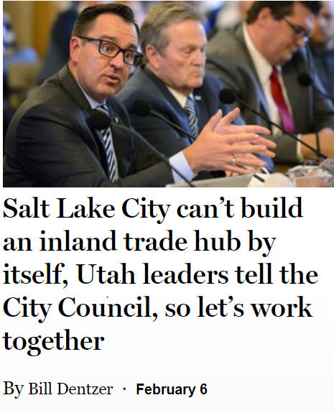
Key bills: water/infrastructure
SB 234 – Utah Inland Port Authority
Land use authority:
creates an appeals panel that will review an administrative land use decision based on a new vague and unenforceable standard: “(1) is detrimental to achieving or implementing the strategies, policies, and objectives stated in Subsection 11-58-203(1); or (2) substantially impedes, interferes with, or impairs authority jurisdictional land development that is consistent with the strategies, policies, and objectives stated in Subsection 11-58-203(1).”
Tax increment

Slide 48
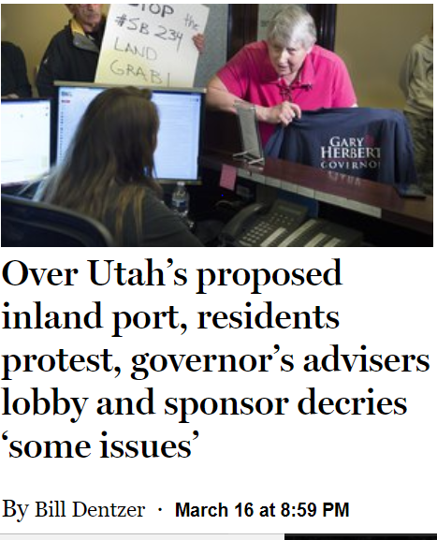
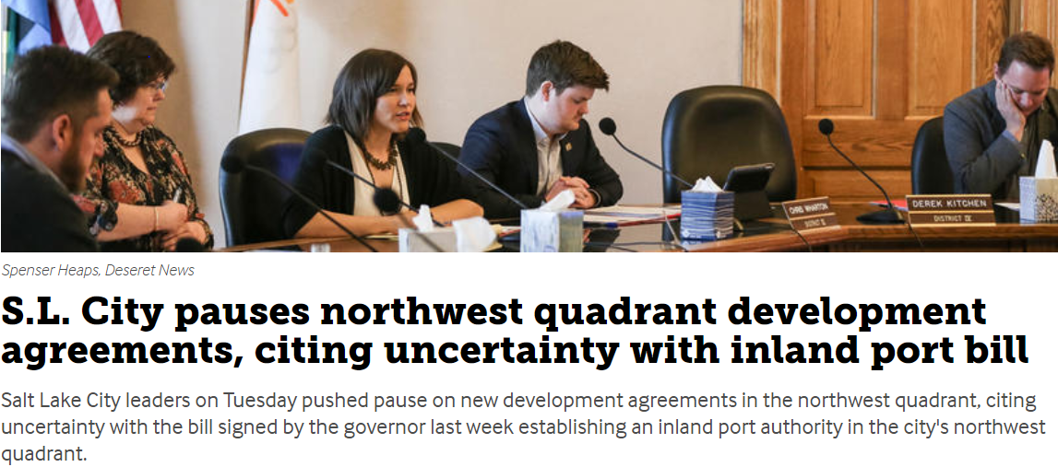

Slide 49
Key bills: transportation
SB 136 – Transportation Governance Amendments
authorizes funding for transit and local needs, and enhances the coordination of transportation, land use, and economic development.
changes name of UTA to Transit District of Utah (as resources allow)
replaces 16-member UTA Board with 3 full-time members and a 9-member advisory board starting November 1st
creates a new Transit Transportation Investment Fund (TTIF) and will transfer funding each year starting in FY19 with $5M
includes land use and economic development considerations in project prioritization and strategic initiatives
phases in an increase of registration fees on alternative fuel vehicles
modifies local option sales taxes.

Slide 50
Key bills: transportation
SB 120 – Local Government Fees and Taxes Amendments
Defines a “transportation utility fee” as an “ongoing, regular fee or tax imposed by a municipality for the purpose of maintaining public roads on utility customers within the municipality.
Prohibits a city from imposing such a fee on a legal subdivision created by the Legislature under Article XI of the state constitution (i.e., a county or a chartered city).
HJR 20 – Joint Resolution Submitting Question to Voters
directs the Lieutenant Governor to present an opinion question to voters at the 2018 regular general election to see if voters support a 10-cents per gallon gas tax increase.
tax would generate approximately $170M in the first year to be split by the standard formula, 30% to “B&C” city and county roads (approx. $50M), and 70% to the state’s transportation fund (approx. $120M)
increase in gas tax revenues would allow the same amount of state sales tax funds to remain in the state’s general fund to be used for public education

Slide 51
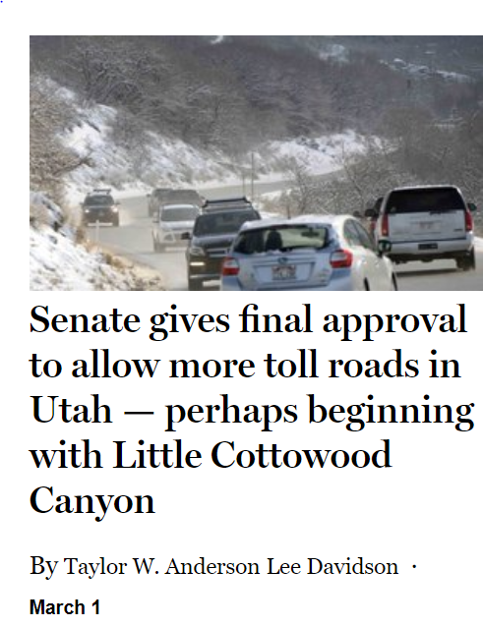
Key bills: transportation
SB 71 – Road Tolls Provisions
allows UDOT to toll existing, new or expanding roads with approval from Utah’s Transportation Commission
requires a study to be completed that analyzes and develops strategies to collect tolls or penalties from rental cars and persons from out of state.
note that the ability to toll existing interstates is very limited and requires federal approval.

Slide 52
Key bills: solid waste
HB 373 – Waste Management Fee Amendments
addresses several issues that followed the passage of last year’s HB 115.
reduces the Department of Environmental Quality’s overall regulatory costs by modernizing and streamlining the non-hazardous landfill inspection process.
eliminates a $400,000 sweep from the Environmental Quality Restricted Account (intended to fund landfill oversight) to the State’s General Fund.
SB 218 – Container Regulation Act (FAILED)
Would have completely pre-empted local government’s ability to regulate, prohibit, or restrict the use of disposable containers (bags, cups, bottles made of paper, plastic, aluminum, etc.)

Slide 53
Key bills: housing
HB 259 – Moderate Income Housing Amendments
requires cities with a population of at least 5,000 have a moderate-income housing element in their general plan
outlines the types of persons, regulations, programs, zoning, and planning that should be considered.
Cities should coordinate with and consider utilizing the programs administered by AOGs
HB 430 – Affordable Housing Amendments
Defines “housing affordability” – the ability of a household to occupy a housing unit paying no more than 30% of the households income for gross housing costs, including utilities.
Creates the Commission on Housing Affordability with DWS – 20 members appointed by various entities
Duties include increasing awareness and understanding of the housing affordability needs in the state, identifying and recommending specific strategies, policies, procedures, and programs to address those needs.
Repealed on July 1, 2023

Slide 54
Key bills: homelessness
HB 462— Homeless Services Amendments
Adds representatives from Ogden, Midvale, St. George, and South Salt Lake to the Homeless Coordinating Committee
The HCC may award a grant for ongoing operations to a homeless shelter that commits to provide matching funds, with priority to the Road Home.
Appropriates $13.2 million to the Housing to Homeless Reform Restricted Account
SB 235 – Homeless Shelter Funding Amendments
Homeless Shelter Cities Mitigation Restricted Account
Annual local contribution = the lesser of $200,000 or an amount equal to 1.8% of the local government’s tax revenue distribution for the previous fiscal year
Allows cities that have a homeless shelter to apply for grants from the HCC to pay for public safety services
Allows an agency to transfer money from a CRA/RDA to the community in order to offset the community’s annual contribution to the Homeless Shelter Cities Mitigation Restricted Account.

Slide 55
ULCT interim projects
Affordable housing/housing affordability
Billboard process
Land Use Task Force: private infrastructure improvements, essential vs. non-essential improvements, subdivisions
Public safety: secondary employment/tier 2 retirement/recruitment and retention
RDAs
Transportation
Tax reform?
Towing
Water: secondary, extra-territorial

