Slide 1
Cemeteries & the clerks- recorders responsibilities

Slide 2
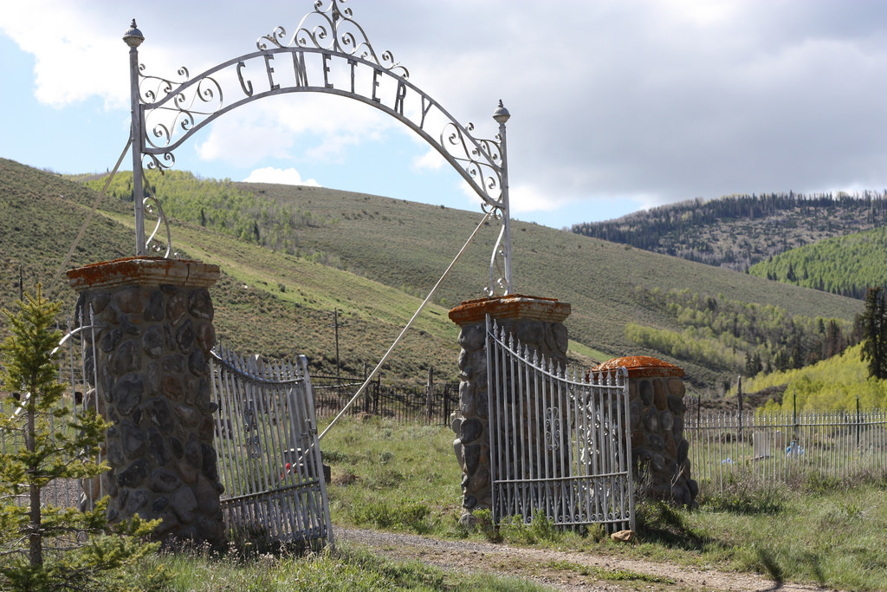
TODAY WE’LL TALK ABOUT…
Compliance Issues/ Codes
Recorded Documents by Statue
Reports Required by Statue
Cemetery Records by Statue
Available Grants
Tools for your Cemetery
Simplify the Process
To Do List
Q & A

Slide 3
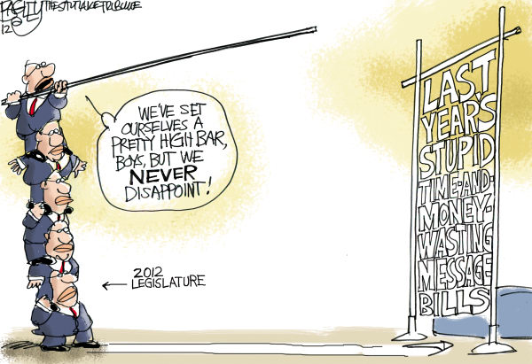

Slide 4
AND THE RESULTS ARE…
2013 Study State Legislative Auditor General
Report ILR 2013-D
Conclusion: It was recommended that “the Legislature consider establishing minimum requirement for operations policies and procedures and the integrity of cemetery records. Included in these minimum standards should be compliance with statutory reporting requirement by the cemeteries to the county recorder.”

Slide 5
UTAH STATE
LEGISLATURE
Title 8 Cemeteries
Chapter 2 Donations for Care
Chapter 3 Recording Plats and Conveyances
Chapter 4 Endowment Care Cemeteries
Chapter 5 Rights and Title to Cemetery Lots
Chapter 6 Policies and Records

Slide 6
CHAPTER 2
DONATIONS FOR CARE
8-2-1 State treasurer to receive donations.
If perpetual care costs are $50 or more for maintenance, improvements or specific embellishments.
(1984)
8-2-2 Investment of funds by Division of Finance.
(Monies invested by State, paid to cemetery owners and used for specific improvements)
(1992)

Slide 7
Chapter 3 Effective 5-13-2014 8-3-1. RECORDING PLATS AND CONVEYANCES
(1) An executive officer of an organization in control of a cemetery, including a cemetery maintenance district, or an individual owner in control of a cemetery, offering burial lots for sale in any county, shall file and cause to be recorded in the office of the county recorder of the county within which the respective cemetery is situated an accurate plat of the cemetery.
(2) The plat required under Subsection (1) shall clearly show:
(a) the sections of burial lots which have been disposed of and the names of the persons owing or holding each burial lot; and
(b) the sections of burial lots held for disposal.
(3) An executive officer or owner shall file additional plats of any addition to a cemetery before offering for sale any burial lots located in the cemetery.
(4) A county recorder may not collect any fee for filing and recording an original plat required under this section.

Slide 8
Record your plat at your county recorder’s office

Slide 9
CHAPTER 3 Effective 5-13-2014
8-3-2. BURIAL RIGHTS - CERTIFICATES
An executive officer of an organization in control of a cemetery, including a municipality or a cemetery maintenance district, or an individual owner in control of a cemetery, shall provide each purchaser of a lot or burial right located in the cemetery with a certificate of burial rights, properly executed.

Slide 10
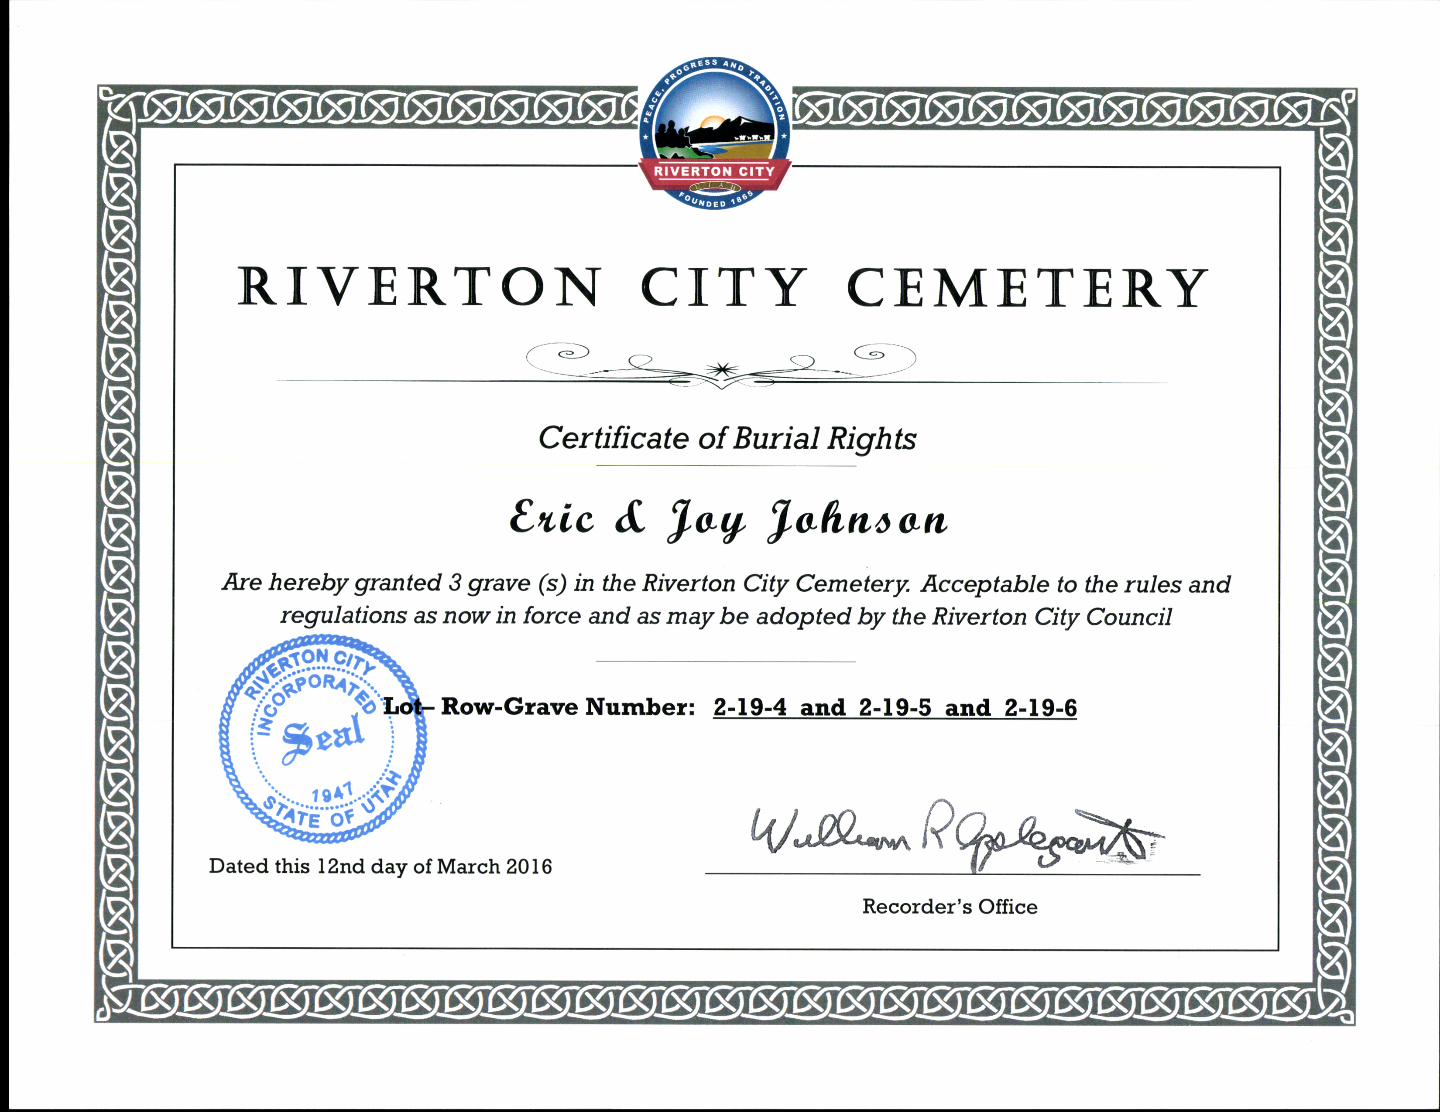

Slide 11
CHAPTER 3
Effective 5-13-2014 8-3-3. TRANSCRIPTS TO BE FILED FOR RECORD
(1) No later than January 1 and July 1 of each year, the executive officer of an organization in control of a cemetery, including a municipality or cemetery maintenance district, or an individual owner in control of a cemetery with burial lots for sale, shall file with the county recorder of the county within which the cemetery is situated a transcript, duly certified by the executive officer or individual owner, of a deed, certificate of sale, or evidence of burial rights issued by the executive officer, individual owner, or the officer’s or owner’s designee during the preceding six months.
(2) The county recorder shall file the transcript described in Subsection (1) without charge.

Slide 12
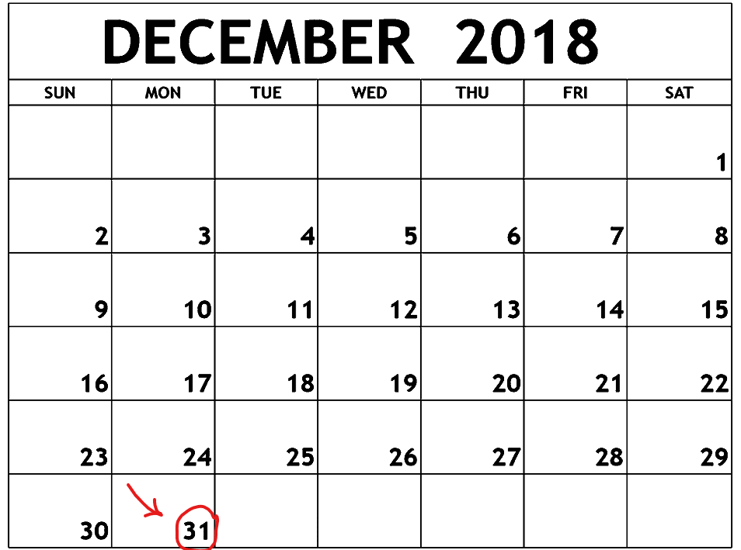
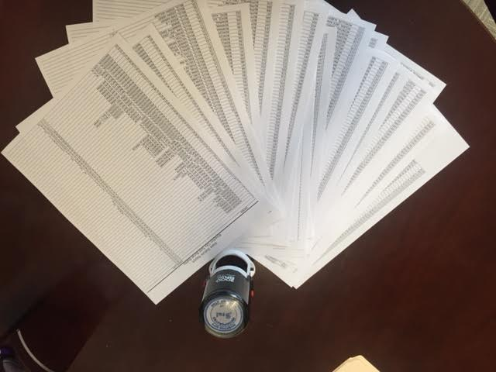
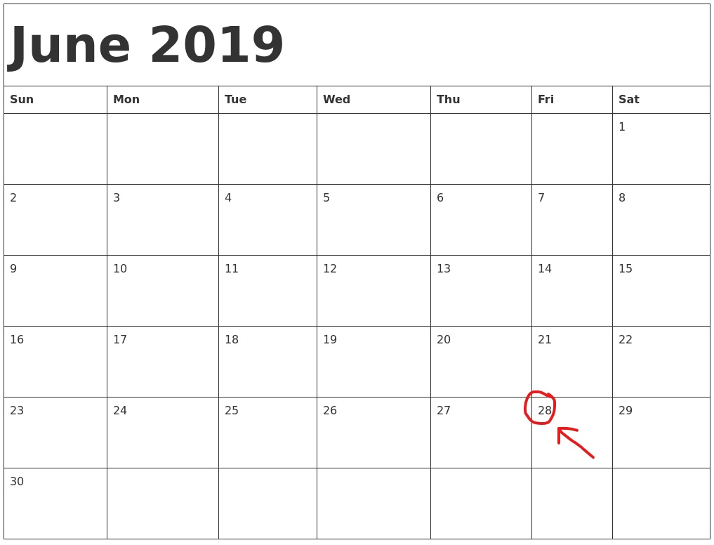
Mark your Calendar
Certify your transcript !
Submit before July 1
and January 1 (2 x per year)

Slide 13
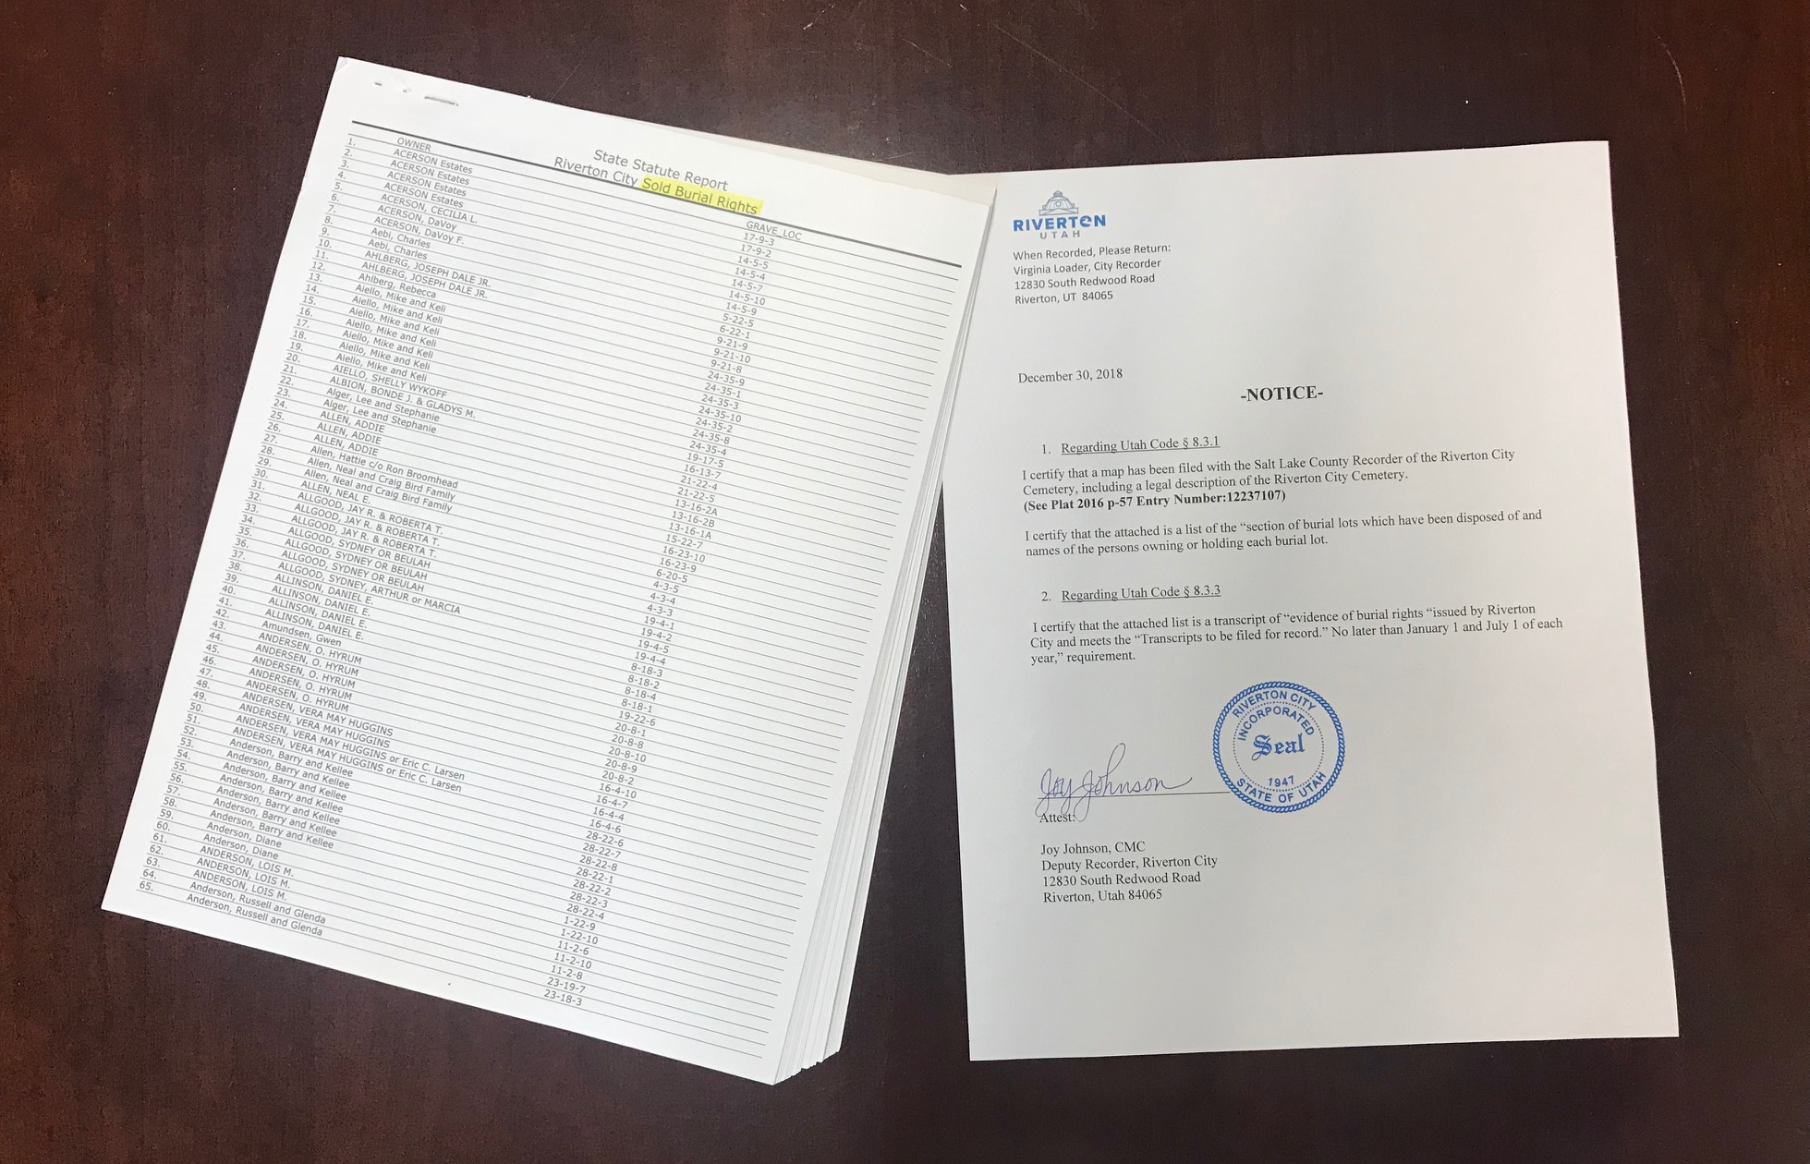

Slide 14
CHAPTER 4
ENDOWMENT CARE CEMETERIES 8-4-1 Entities Subject To Chapter (Public Cemeteries) – Definitions (1996)
8-4-2 Endowment care cemetery trust funds (Finances, Investments, Requirements) -- Deposits in endowment fund -- Reports -- Penalties for failure to file -- Investment of trust fund money -- Attestation. (2010)
8-4-3 Withdrawals from endowment fund. (2000)
8-4-4 Insufficiency in endowment fund. (1996)

Slide 15
CHAPTER 5 Rights and Title to Cemetery Lots
8-5-1 Unused or unkept lots – (60 year rule) Notice procedures. (2002)
8-5-2 Action in district court for title to lots. (2002)
8-5-3 Abandonment -- Standards -- Prima facie evidence. (2002)
8-5-4 Copy of judgment to be filed with county recorder. (1985)
8-5-5 Proceeds of resale of lots. (2007)
8-5-6 Alternative council or board procedures for notice (publish for 3 weeks) -- Termination of rights. (2009)
8-5-7 Sale of only right to be buried. (2002)
8-5-8 Municipal and maintenance district cemeteries – (sell back or exchange) Rights of lot holders – Compensation -- Perpetual care charges. (2002)

Slide 16
CHAPTER 6
EFFECTIVE 5/13/2014 Policies and Records
8-6-2 Policies adopted and records kept.
A cemetery maintenance district, municipality, individual, or other person that controls a cemetery shall:
(1) adopt policies and procedures for the regulation of its affairs and the conduct of its business, including policies and procedures for the following:
(a) setting of prices and other charges for services;
(b) sale of burial rights;
(c) regulation of headstones;
(d) care of headstones;
(e) regulation of flowers, shrubs, or other foliage placed or planted on an individual burial site; and
(f) compliance with provisions of this title and other governing provisions of law; and
(2) establish a record keeping system, including a secure backup of the records that is regularly updated.

Slide 17
UTAH ADMINISTRATIVE CODE
EFFECTIVE 2/1/2016
R436-9-1. Persons and Institutions Required to Keep Monthly Listings of Vital Statistics Events.
Hospitals, birthing centers, and maternity homes shall prepare a monthly listing of all births that occurred in their facilities. This listing shall include the date of birth, the parents' names, the sex of the child and the name of the medical attendant. The aforementioned facilities shall also gather and keep in their files all the information needed to complete the birth certificates for these deliveries. Hospitals are also required to include on the listing all induced abortions (names not required) occurring in their facility.
Hospitals and nursing homes shall prepare a monthly listing of all the deaths and fetal deaths that occurred in their institutions. The listing should include date of death, name of the deceased, age, name of the medical attendant, name of the funeral director or the person acting as such.
Funeral directors shall keep a listing of all deaths for which they conducted a funeral or provided a casket. The funeral director's listing shall include the county where the death occurred in addition to the required identifying information. Sextons or other persons in charge of cemeteries shall prepare a listing of all burials and other dispositions in their cemeteries. The listing should include the date of death, name of the deceased, age, county where death occurred, and name of the funeral director or the person in charge of the burial.
The above listings shall be prepared in triplicate on forms provided by the State Registrar. One copy is to be sent to the State Registrar, one to the local registrar of the area where the facility is located, and the third is to be kept by the agency which prepared it.
These reports are to be mailed by the tenth of the month following the month of occurrence. (1989)

Slide 18
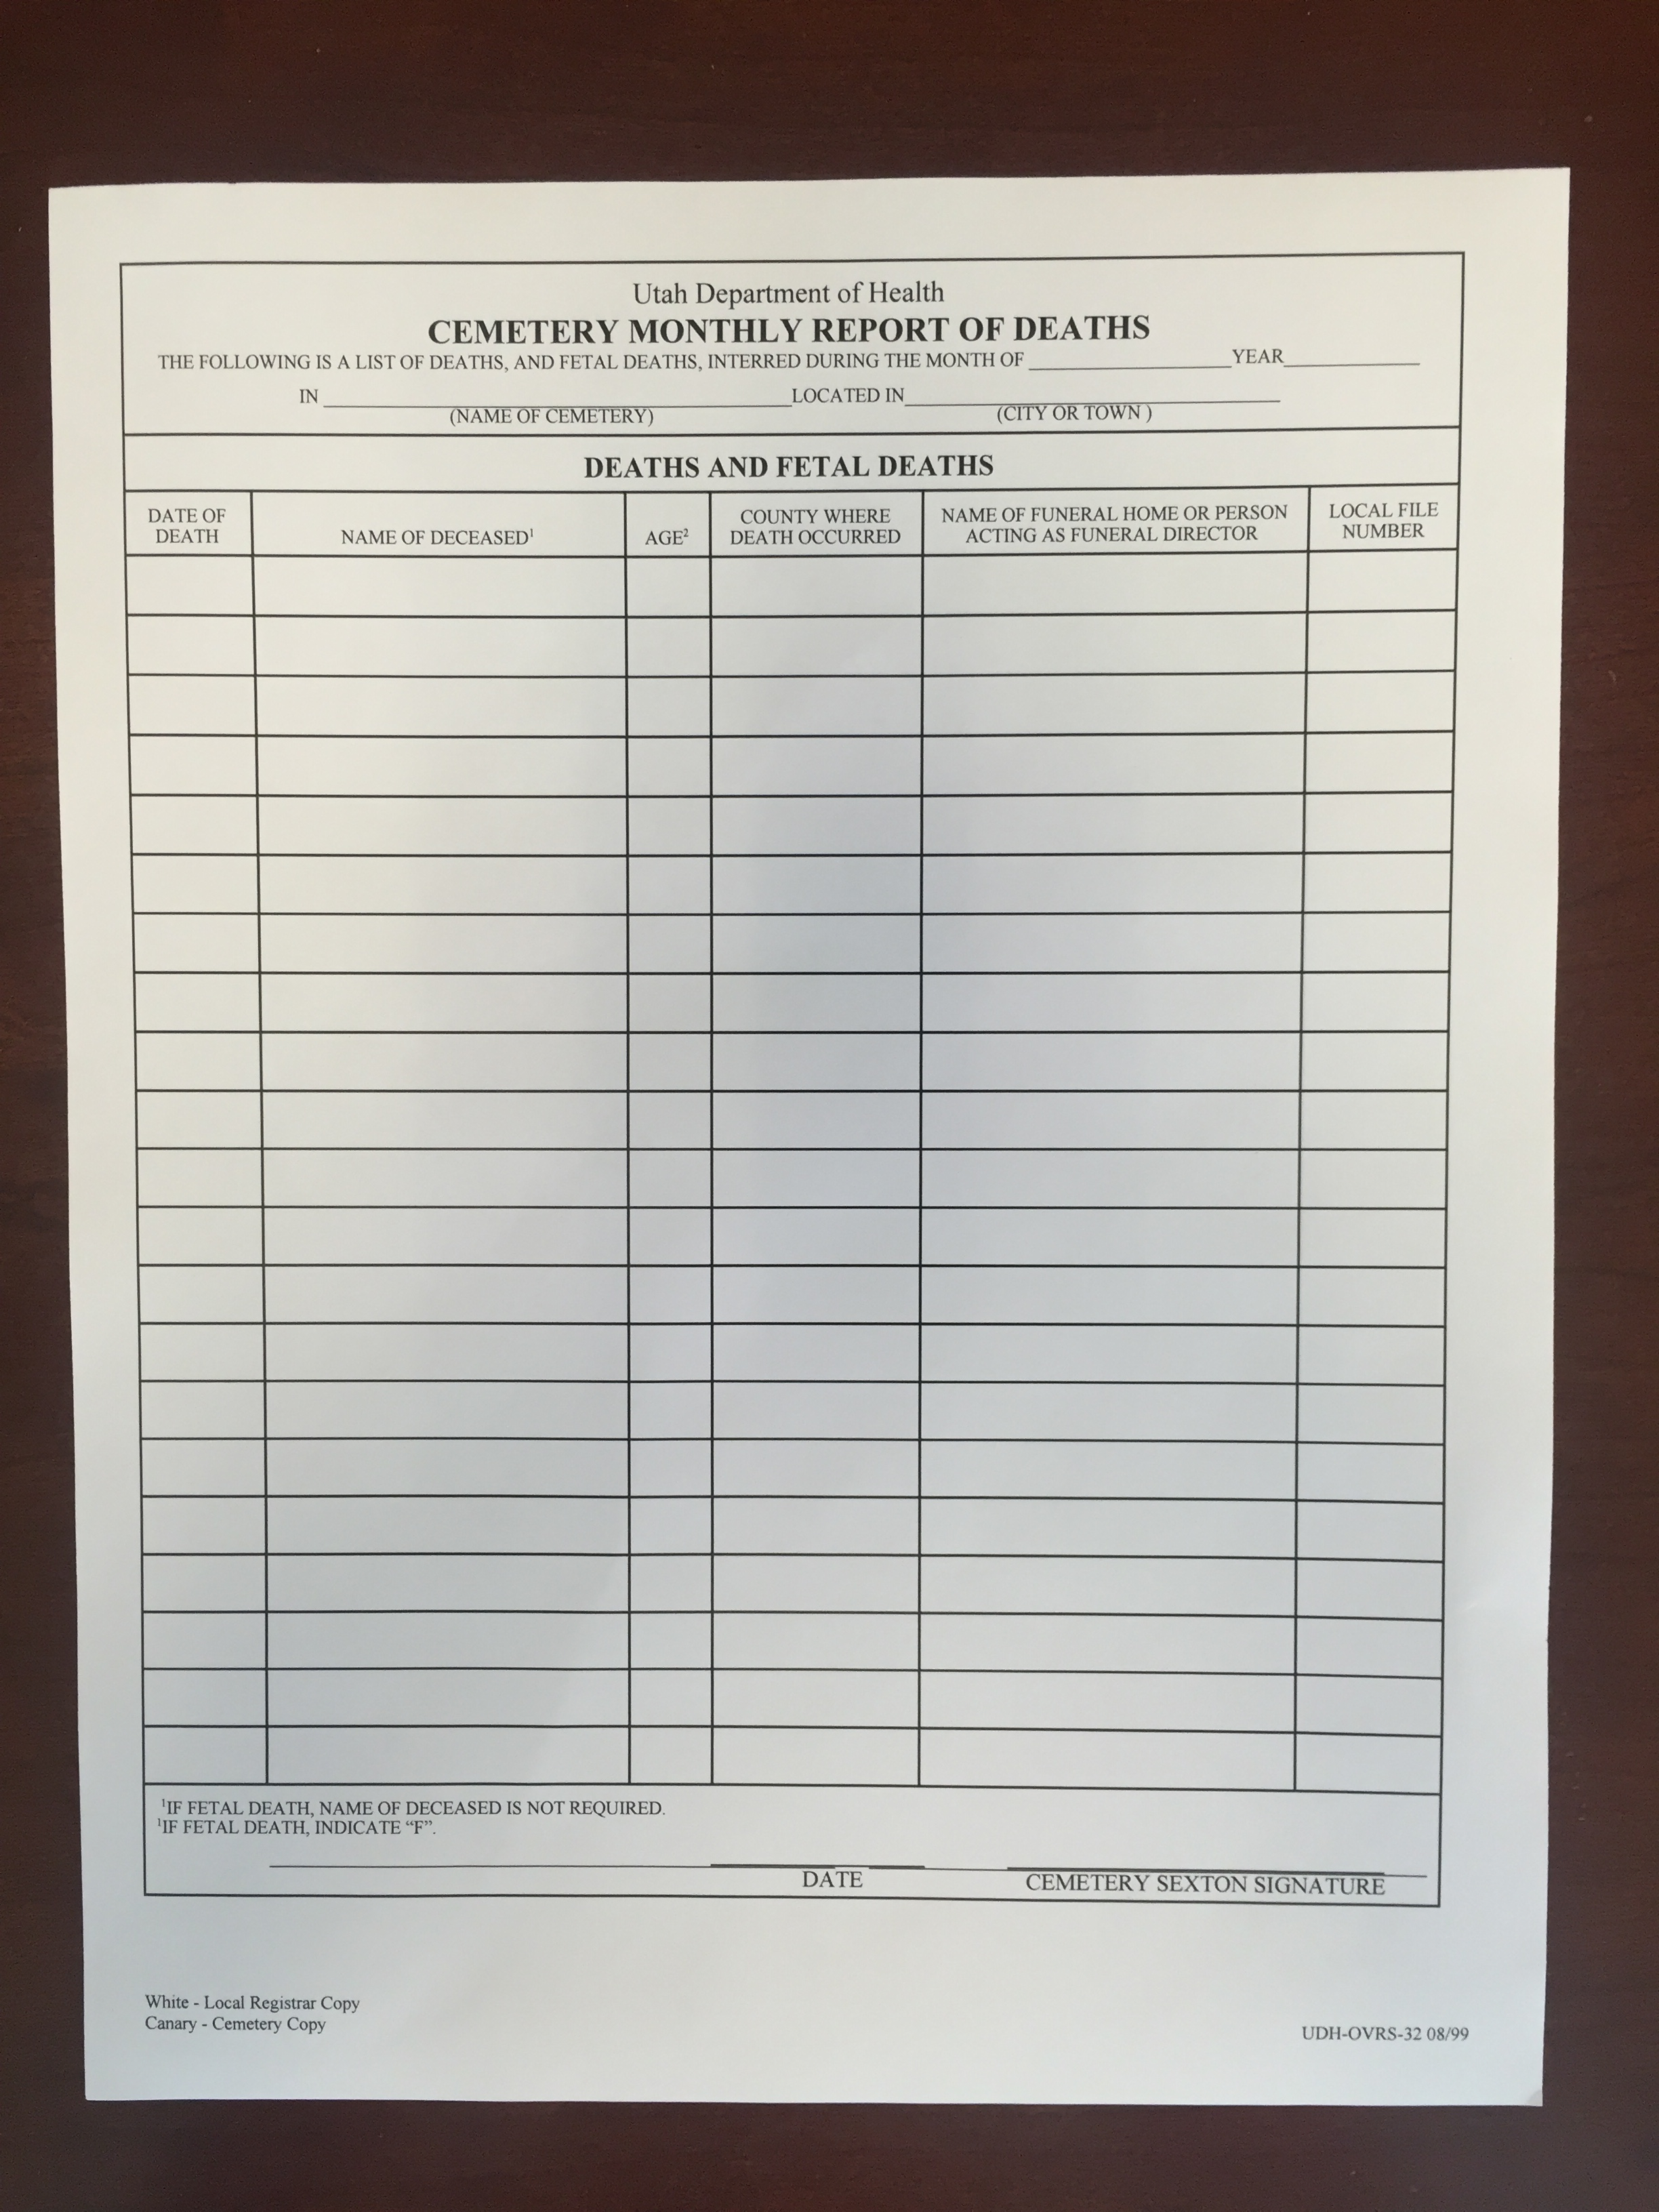
Send a Monthly Report of Burials to:
YOUR County Deputy Registrar of Vital Statistics

Slide 19
Utah State County Vital Records Offices (13)
Bear River Health Department
Cache, Box Elder, Rich
Central Utah Health Department
Juab, Millard, Piute,
Sanpete, Sevier, Wayne
Davis County Health Department
Davis
Salt Lake County Health Department
Salt Lake
Southeast Public Health Department
Carbon, Emery, Grand
San Juan Public Health Department
San Juan
Southwest Utah Public Health Department
Garfield, Washington,
Beaver, Iron, Kane
Summit County Health Department
Summit
Tooele County Health Department
Tooele
Tri-County Health Department
Daggett, Duchesne, Uintah
Utah County Health Department
Utah
Wasatch County Health Department
Wasatch
Weber/Morgan Health Department
Weber, Morgan

Slide 20
AMY BARRY
Utah Division of State History,
Cemeteries & Burials
1. Utah Code 9.8.203
2. Grants Are Available
3. What I Need from You

Slide 21
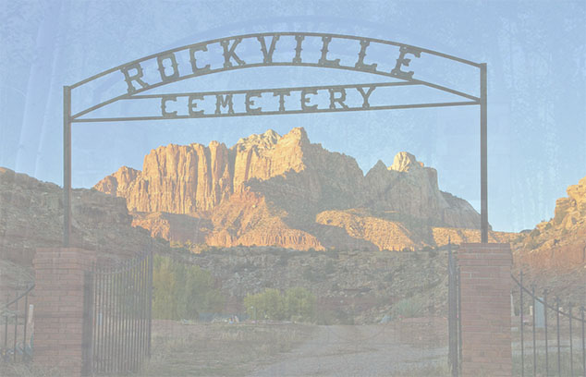
Utah Cemeteries & Burials Program
Cemeteries should be more than places where stones lie on the ground. Cemeteries hold the stories of the people who have lived in the past… people who have shaped our past. – Audrey Bierhans

Slide 22
An important part of what the state does is preserving its history. – James R. Thompson
The Division of Utah State History has a mandate to create and maintain a searchable database of Utah cemeteries and burials.
Title 9, Chapter 8, Part 203 (3c)
Create and maintain a computerized record of cemeteries and burial locations in a state-coordinated and publicly accessible information system.
www.history.utah.gov
We have 683,862 burial records for 604 cemeteries.

Slide 23
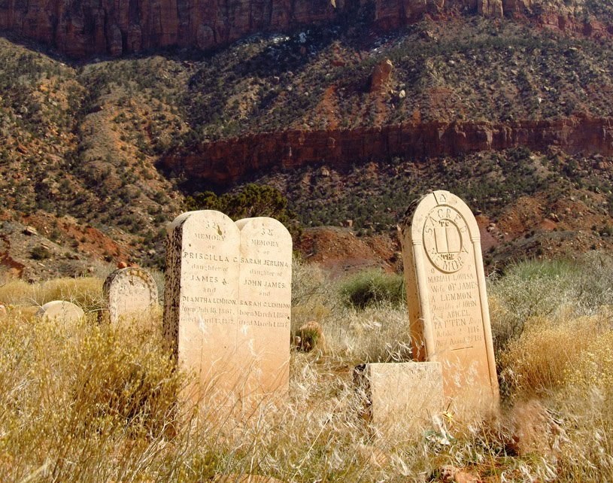
WHAT’s NEW…
So much of our future lies in
preserving our past.
– Peter Westbrook
Grants
Matching grant up to $10,000
Does not have to be dollar for dollar
Qualifying projects
Preservation (headstones, fencing, restoration, etc.)
Digitization
Website
www.history.utah.gov/cemetery-grants-program
Working on new website/database interface for geo-spatial data.
Veteran Service
Compiling data for service members to include Veteran status, War(s) Served and Military Branch(es).

Slide 24
What I need from you…
1. Cemetery Information Sheet
2. Annual report of burials

Slide 25
WWW.HISTORY.UTAH.GOV
OUR WEBSITE…
Family Tree Magazine named as a top website for 2015.
What sets us apart is our source.
Our data comes from the cemetery sexton.
When available we use death certificates to enhance the data.
We have 659,759 burial records for 575 cemeteries.

Slide 26
GRANTS…
So much of our future lies in preserving our past.
– Peter Westbrook
State History provides a grant up to $10,000 as a match.
Does not have to be a monetary match.
Can include donated services, goods, etc.
Help cemeteries digitize or upgrade their records.
www.history.utah.gov/cemetery-grants-program.

Slide 27
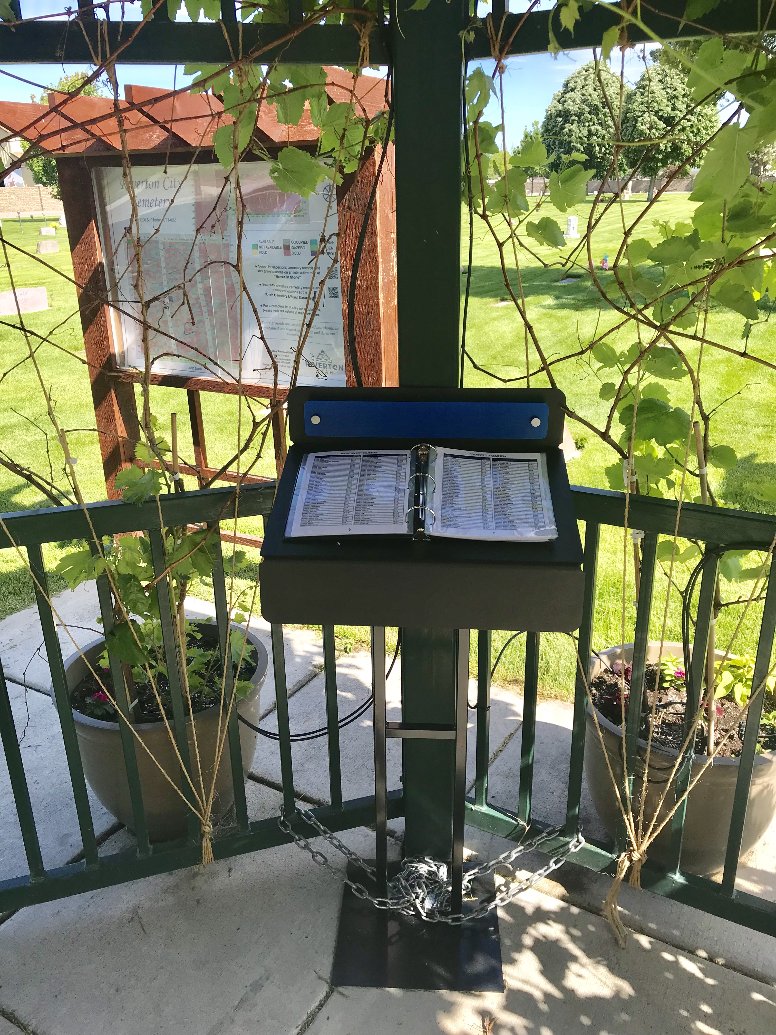
Suggestions-Tips-Tools for your cemetery Post a Map Add a QR Code Post a List
SEND UPDATE TO STATE
SEND AN UPDATED E-FILE OF YOUR CEMETERY
“DECEASED LIST”
TO: AMY BARRY amybarry@Utah.gov
EVERY YEAR
I USE MEMORIAL DAY.

Slide 28
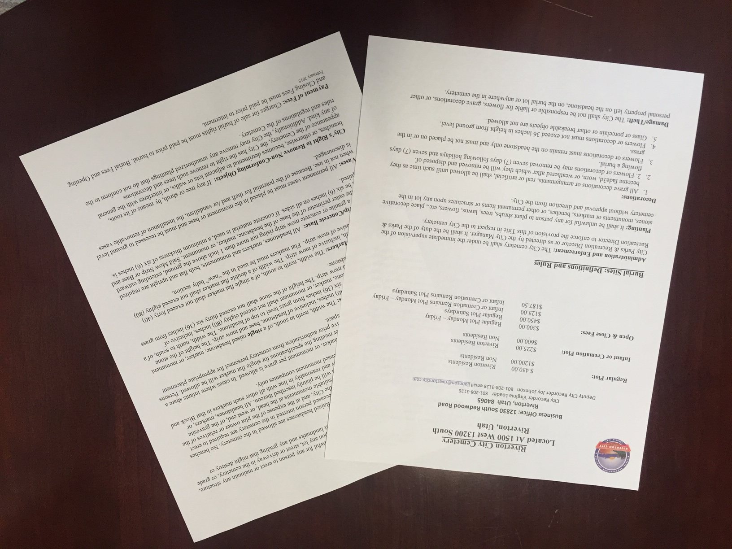
POST YOUR RULES, REGULATIONS AND FEES
ON YOUR WEBSITE

Slide 29
UFDA (Utah Funeral Directors Association)
Within the State of Utah there is a funeral directors association. It is a good way to communicate with 90% of the funeral directors in the state.
You can contact them via www.ufda.org
Funeral Directors travel with burials to all cities through out the entire state, the more info they have - the more content families will be.

Slide 30
REQUIRED
CEMETERY TO DO CHECK LIST
Review Utah Code § 8, Cemeteries, then review it again.
Record Cemetery Plat showing burial lots which have been disposed of and the names of the persons owning each burial lot with your County Recorder.
3. Provide each purchaser a certificate of burial rights, properly executed.
No later than January 1 and no later than July 1, file with the County Recorder a transcript, duly certified, of evidence of burial rights issued during the preceding six months.
Adopt Policies and Procedures including prices, regulation of headstones, care of headstones, and regulation of flowers, shrubs and so forth.
6. Establish a record keeping system including a secure backup of these records that is regularly updated.
Comply with Administrate Rule 436 and provide to your county Vital Records Office a monthly list of all burial and other dispositions in your cemetery.
Comply with Utah Code 9.8.203 and submitting annually to Utah Division of State History, a list of burials including, grave location, deceased name.
September 2018

